Slide 1
LING-L542: Phonological Analysis Final Project
Andrew Davis, Lily Kawaoto Fall 2021

Slide 2
Introduction
Imagine, as a Linguist/Phonologist, you have a body of text or a dataset from the language of your study, and you want to extract the distinctive, phonological features demonstrated in the sounds/text provided...

Slide 3
What are we doing? Why does it matter?
Phase I:
take data from a language in terms of orthographic/IPA text
produce the relevant Phonological features & assign relevant features to corresponding IPA symbol
group the phonemes based on a matrix with qualitative feature weights
produce an array of this data for the user
Phase II – Analyze & Refine:
incorporate probabilities (e.g. of bigrams of phonemes) into the model, which will improve our relationship graph
Train a neural network model with these, compare quantitative frequency with the qualitative data to identify core vs peripharal sounds of a language; Utilizing Deep Learning & Dense Embedding
Why does this matter?
Bridge the gap in terms of manual labor associated with analyzing a dataset in isolating core vs peripharal sounds of a language
Determine/predict core sounds from peripheral sounds in languages: L2 Acquisition, Speech Recognition/NLP (AI) (GPT-3 Example), Jenga Example

Slide 4
Methodology

Slide 5
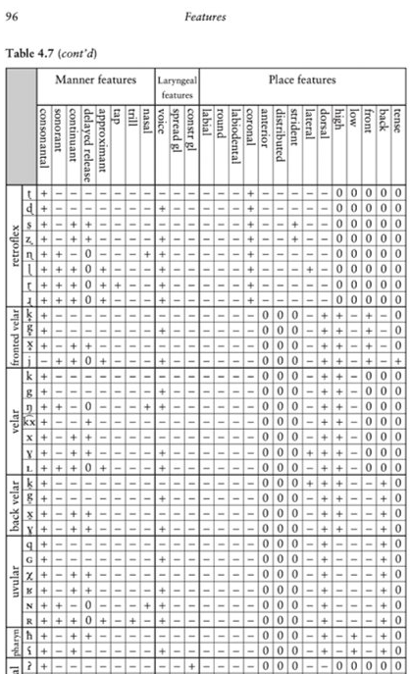
Step 1a: Create a Table of IPA Features
Based off the IPA feature chart created for PanPhon
Make the chart more closely aligned with Hayes (2009)
Added Dorsal, labiodental
Removed high/low tone
Hayes (2009). Introductory Phonology.

Slide 6
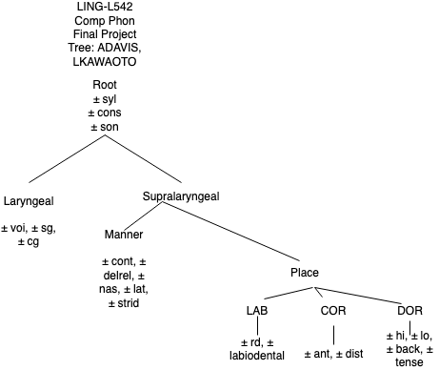
Step 1b: Create a Table of IPA Features – Create Tree
Create Feature Geometry Tree of relevant features in this Data to act as standard; keeps it uniform

Slide 7
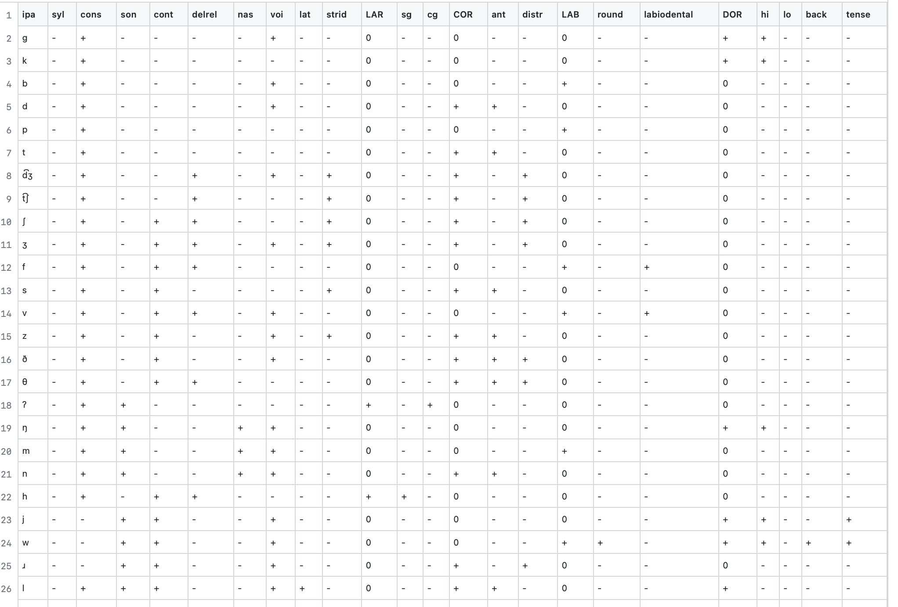
Step 1c: Create a Table of IPA Features
Based off the IPA feature chart created for PanPhon
Make the chart more closely aligned with Hayes (2009)
Added Dorsal, labiodental
Removed high/low tone
Our final chart of English IPA symbols and their features
Notes:
PanPhon: open-source resource for mapping IPA features to articulatory feature vectors

Slide 8
Step 2: Represent features into Computer-Readable Format
How to represent +/- features into reasonable numbers?
Feature geometry tree...
Assign "weights" to each feature
+1 --> presence of feature (binary)
+2 --> presence of feature (unary)
-1 --> absence of feature
0 --> lack of feature
These numbers get stored in an abstract computer "container" called a vector
Normalized numbers in the vectors to be between 0 and 1
[0.0,0.6666666666666666,0.0,0.0,0.0,0.0,0.6666666666666666,0.0,0.0,0.3333333333333333,0.0,0.0,0.3333333333333333,0.0,0.0,0.3333333333333333,0.0,0.0,1.0,0.6666666666666666,0.0,0.0,0.0],
[0.0,0.6666666666666666,0.0,0.0,0.0,0.0,0.0,0.0,0.0,0.3333333333333333,0.0,0.0,0.3333333333333333,0.0,0.0,0.3333333333333333,0.0,0.0,1.0,0.6666666666666666,0.0,0.0,0.0],
[0.0,0.6666666666666666,0.0,0.0,0.0,0.0,0.6666666666666666,0.0,0.0,0.3333333333333333,0.0,0.0,0.3333333333333333,0.0,0.0,1.0,0.0,0.0,0.3333333333333333,0.0,0.0,0.0,0.0],
…
Notes:
Why normalize data? So that all the numerical processes are scaled the same way throughout the project.
Orange1 = /g/
Orange2 = /k/
Blue1 = syllabic
Blue2 = consonantal
Blue3 = sonorant

Slide 9
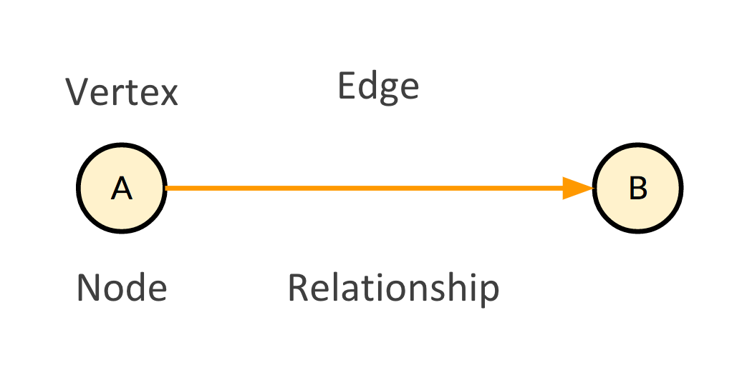
Step 3: Visualize Feature Vectors
Used another open-source programming package called NetworkX to make graphs
How to represent graphs?
An edge connects 2 nodes -->
[Node1, Node2, EdgeWeight]
Node1 = IPA symbol
Node2 = feature
EdgeWeight = corresponding number in the feature vector from Step 2
["k", "syl", 0.0], ["k", "cons", 0.6666666666666666], ["k", "son", 0.0], ["k", "cont", 0.0], ["k", "delrel", 0.0],
["k", "nas", 0.0], ["k", "voi", 0.0], ["k", "lat", 0.0],
["k", "strid", 0.0], ["k", "LAR", 0.3333333333333333], ["k", "sg", 0.0], ["k", "cg", 0.0], ["k", "COR", 0.3333333333333333], ["k", "ant", 0.0],
["k", "distr", 0.0], ...

Slide 10
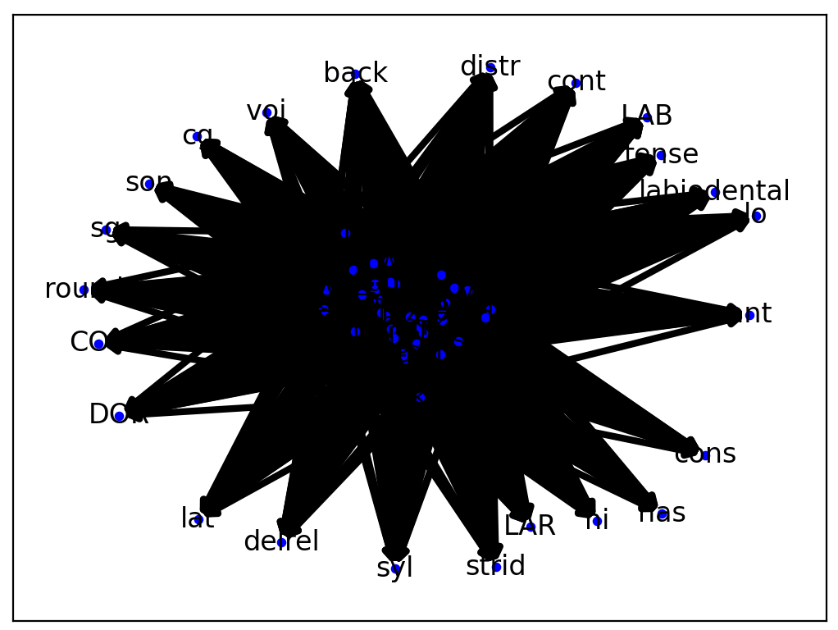
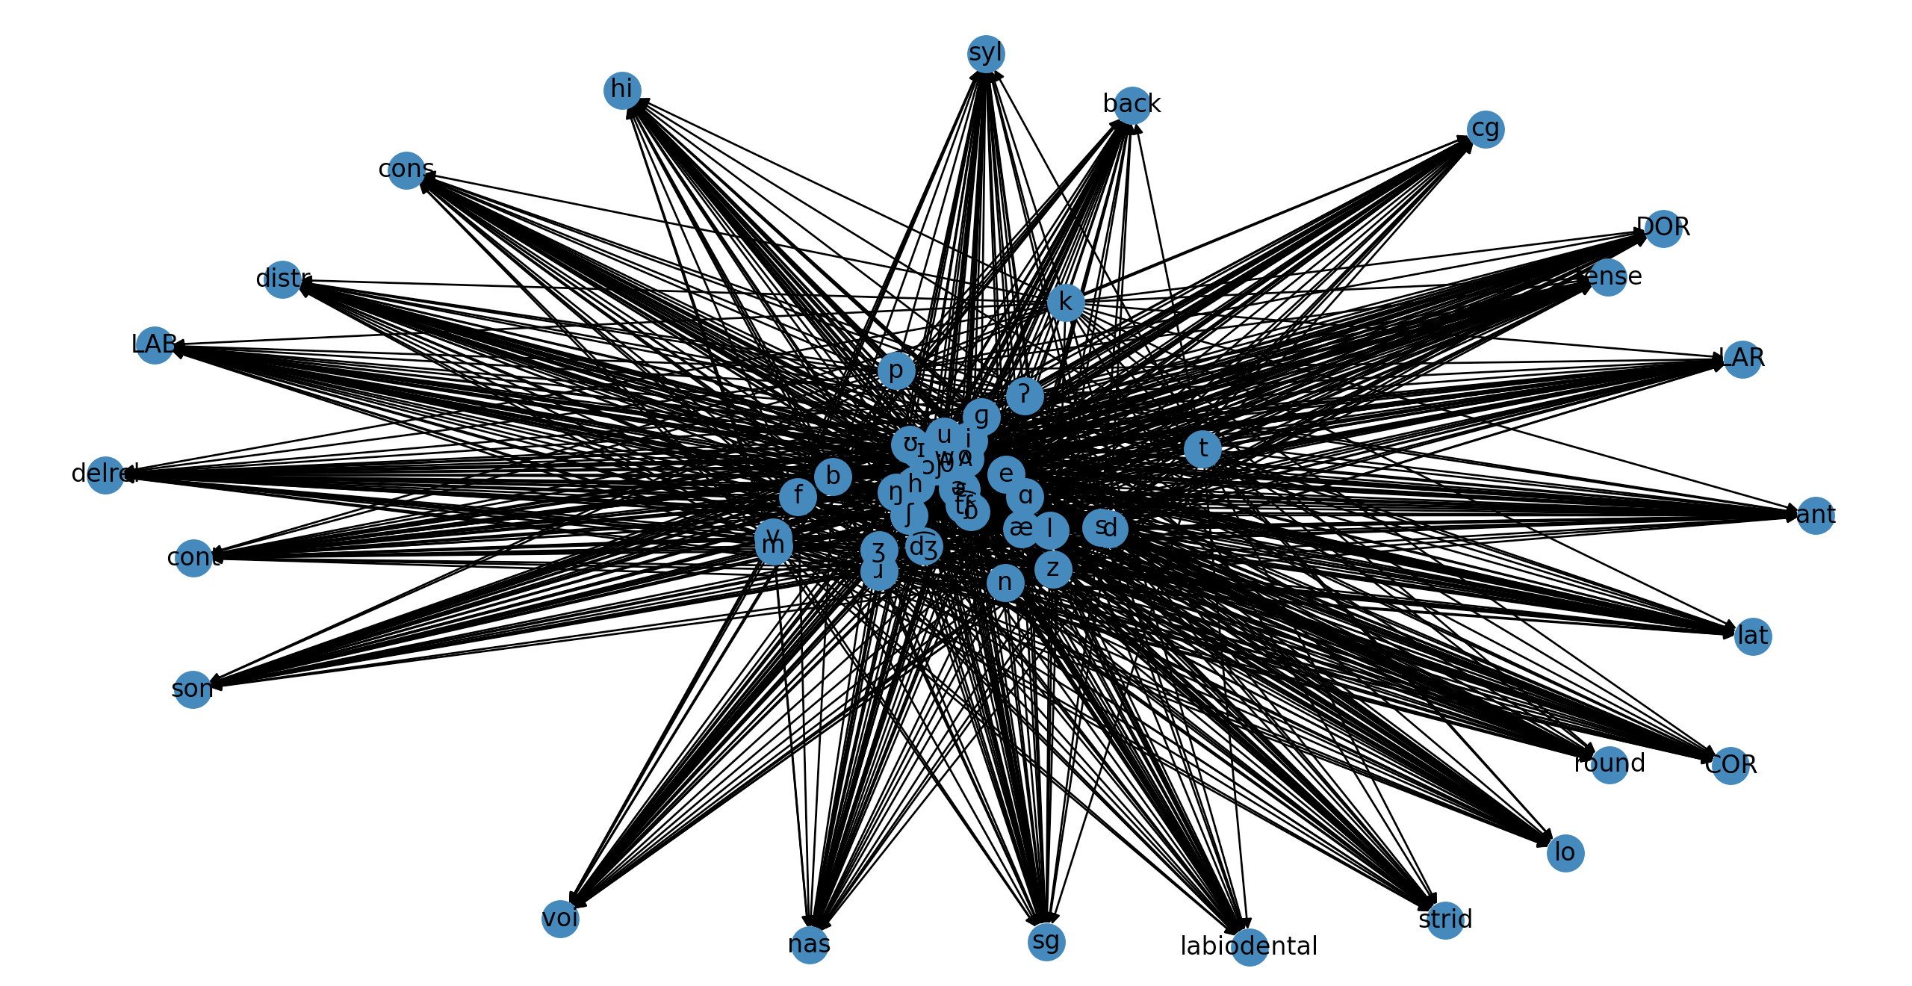
Step 3: Visualize feature vectors
2nd Iteration of Graphs, #1
1st Iteration of Graphs
Progress of graphs after tweaking settings?

Slide 11
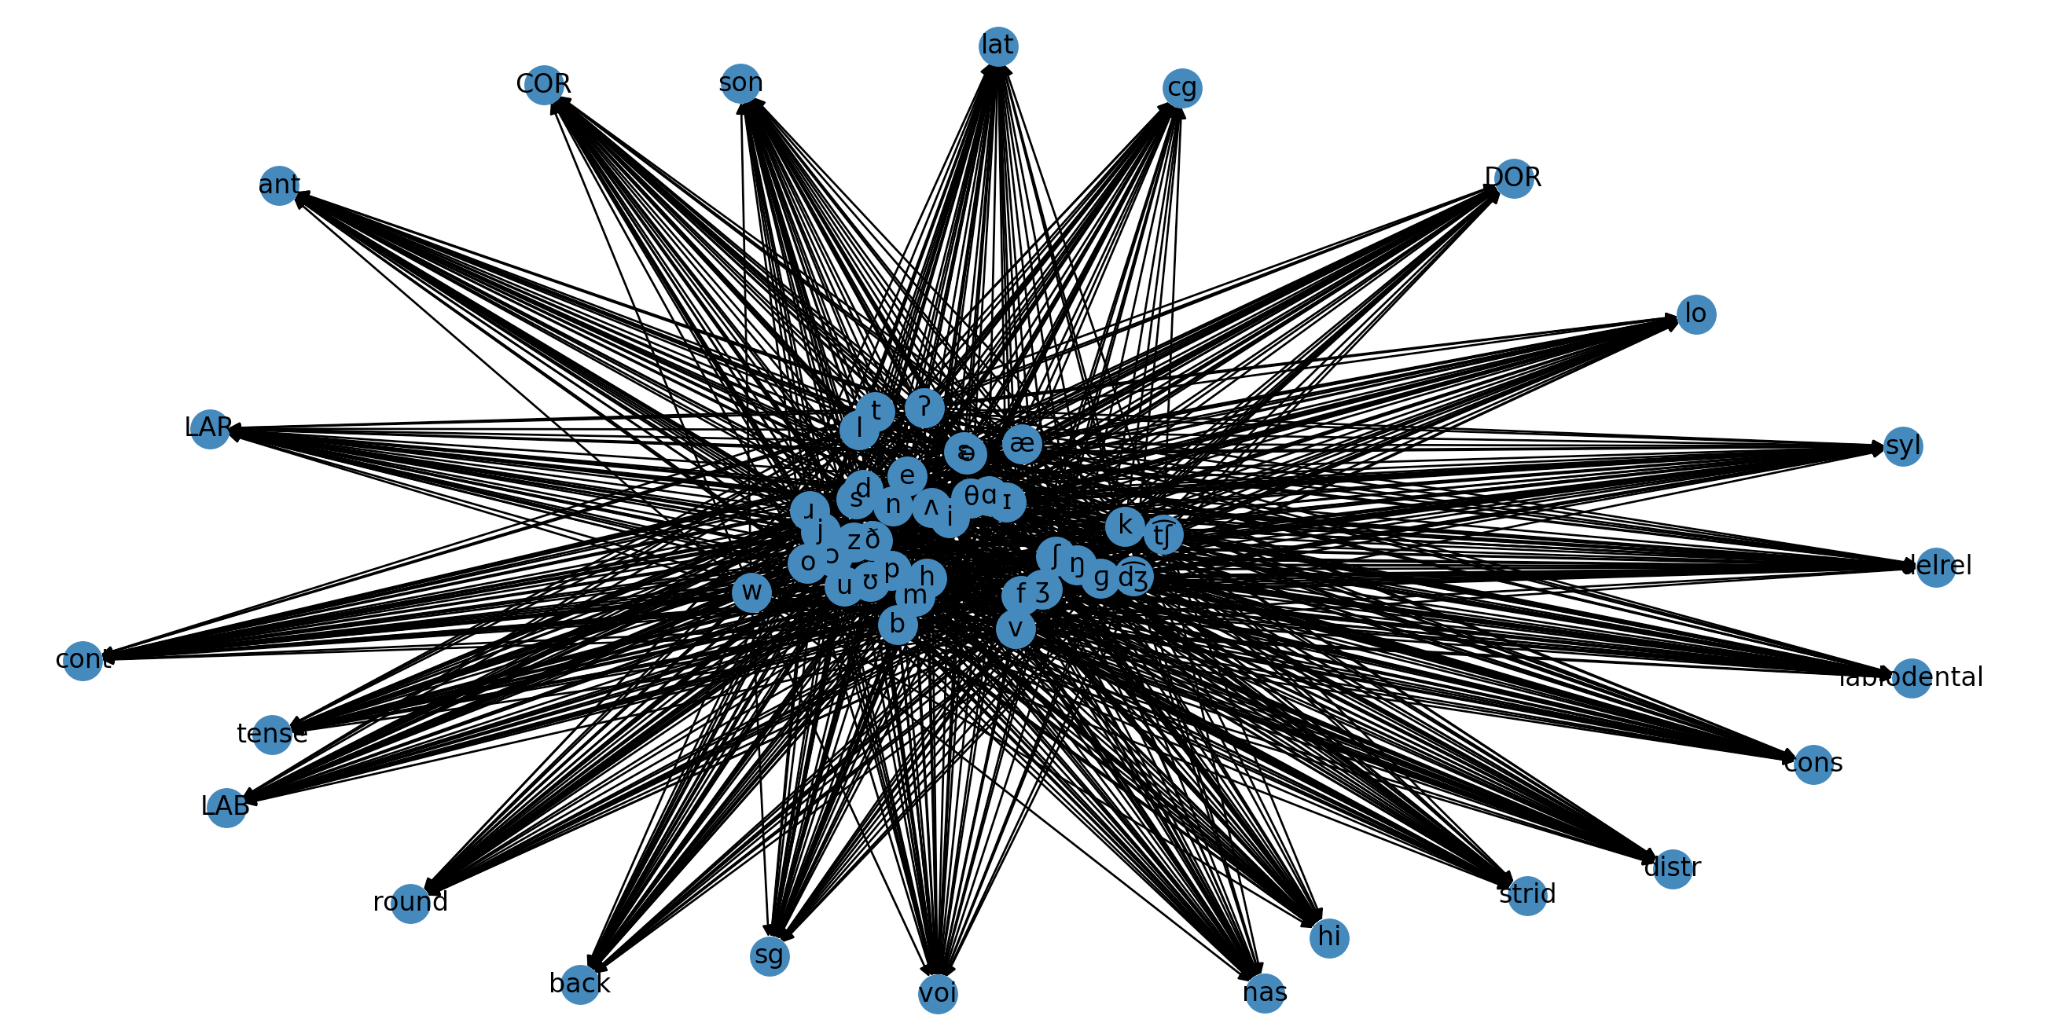
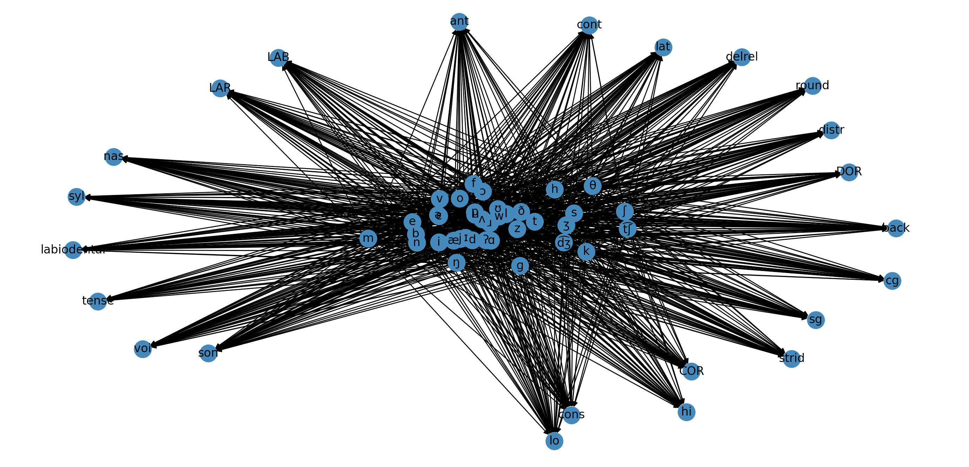
2nd Iteration of Graphs, #2
2nd Iteration of Graphs, #4

Slide 12
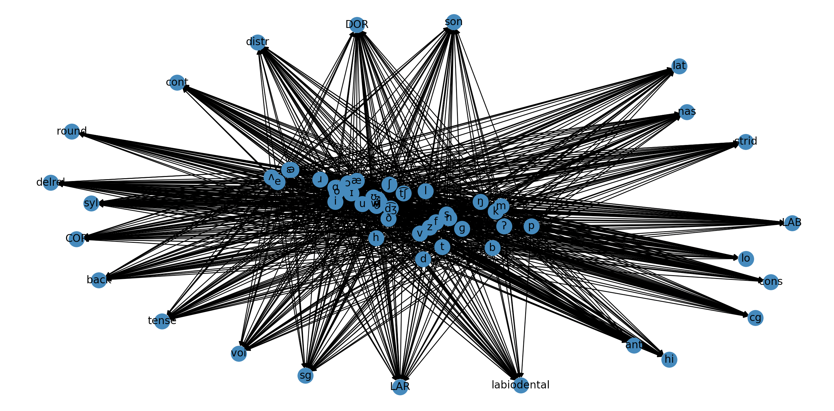
2nd Iteration of Graphs, #3

Slide 13
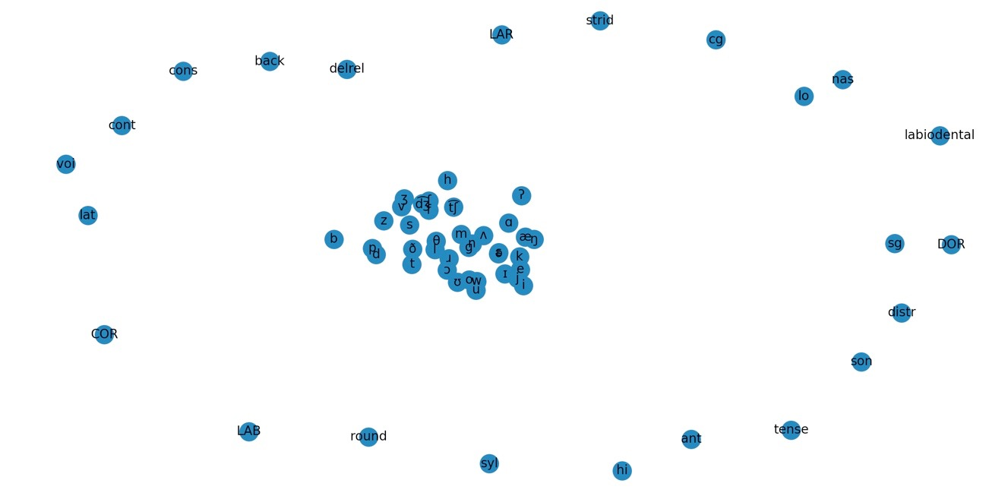
3rd Iteration of Graphs, #2

Slide 14
Graph Analysis
Do you agree / disagree with the graph representation?
What do you notice about the IPA symbols and their position in relation to the features?
Recall back to our table, did you agree with the changes to Hayes representation in terms binary/unary features that we made?
Phase I Analysis/Observations: manner > place > voice

Slide 15
Next Steps

Slide 16
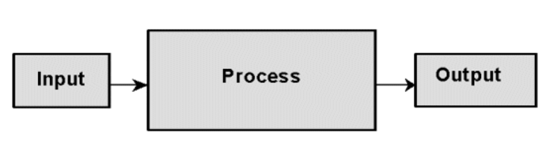
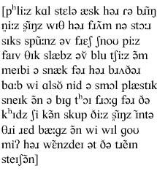
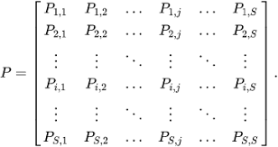
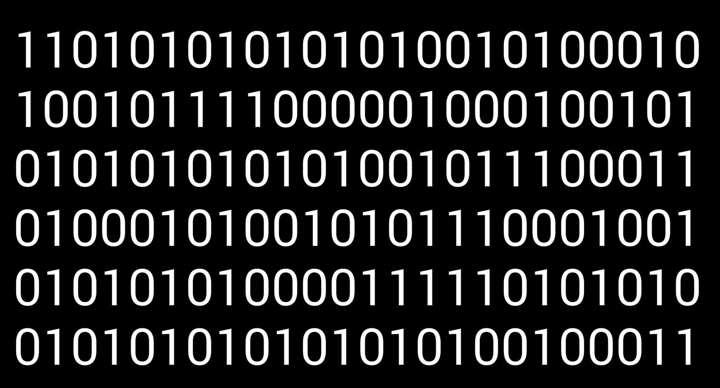
Our Roadmap
"gold standard"
Notes:
model takes in text data of real-life speech from native speakers (preferably already transcribed into IPA symbols), learns the phonotactic patterns of English, and generates probabilities of 2+ phonemes occurring in sequence. (gold standard)

Slide 17
Future Applications
Compare qualitative data to quantitative data based on distributional frequency in phonotactic datasets (I.e. frequency of x occurring next to y)
Scaling weight of relationships based on above; creates a magnetic attraction between like-sounds, phonemic clusters, and entire languages (core elements at the center and peripharal sounds on the fringes)
Compare this with qualitative data analyze accuracy, refine, re-train model (Dense Embeddings for each sound)
Create a standard/score based on this etc
Graphs Validate the Data
Native vs L2 English speakers, L2 Acquisition
Measure distance (could be score mentioned above) in terms of acoustic and articulatory differ
Tentative Datasets
Annotated Data Available: http://www.voxforge.org/ , https://sla.talkbank.org/TBB/childes/Other/Arabic/Salama/AbdrahmanFawzy.cha , etc
Working with locally annotated data
Notes:
apply this to English phonotactics & maybe compare that to the phonotactics of L2 speakers (e.g. using data from Speech Accent Archive)... in which case word embeddings (looking at the preceding and succeeding phonemes) would be exactly what we’d need

Slide 18
References
Aric A. Hagberg, Daniel A. Schult and Pieter J. Swart, “Exploring network structure, dynamics, and function using NetworkX”, in Proceedings of the 7th Python in Science Conference (SciPy2008), Gäel Varoquaux, Travis Vaught, and Jarrod Millman (Eds), (Pasadena, CA USA), pp. 11–15, Aug 2008
David R. Mortensen, Patrick Littell, Akash Bharadwaj, Kartik Goyal, Chris Dyer, Lori Levin (2016). "PanPhon: A Resource for Mapping IPA Segments to Articulatory Feature Vectors." Proceedings of COLING 2016, the 26th International Conference on Computational Linguistics: Technical Papers, pages 3475–3484, Osaka, Japan, December 11-17 2016.
Notes:
In order: (1) NetworkX, (2) PanPhon

